Slide 1
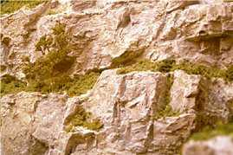
Preikestolen
“The Rock Pulpit”
Translated from the original Italian by Cassius Carter

Slide 2
Near Stavanger in Norway there is a mysterious rock that rises 600 meters above the fjord Lysefjorden and to get there is not a climber's dream!
The Preikestolen (literally “Rock Pulpit” is perhaps the most famous attraction in Stravanger. Once you've arrived at the parking lot at an elevation of about 270 meters, you're at the beginning of the trail that leads to the summit of the rock terrace from which in a little less than two hours and another 600 meters you will get to the peak of the fjord.
To say that you'll enjoy a breath taking view is a no brainer! However be sure you are properly equipped to go on even though the trail is well tracked, good trekking shoes are strongly advised.
You have to be in good physical condition!

Slide 3
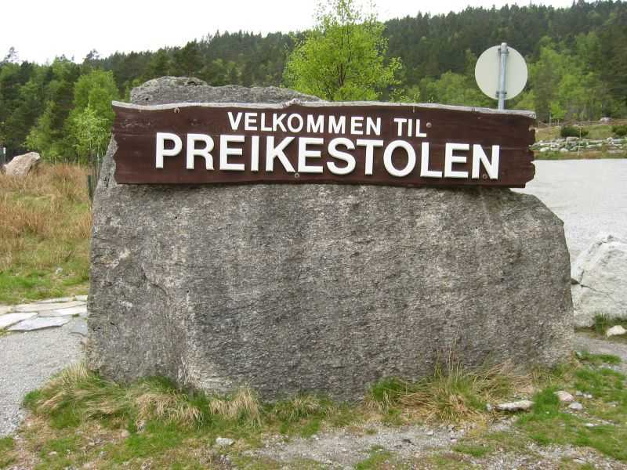

Slide 4
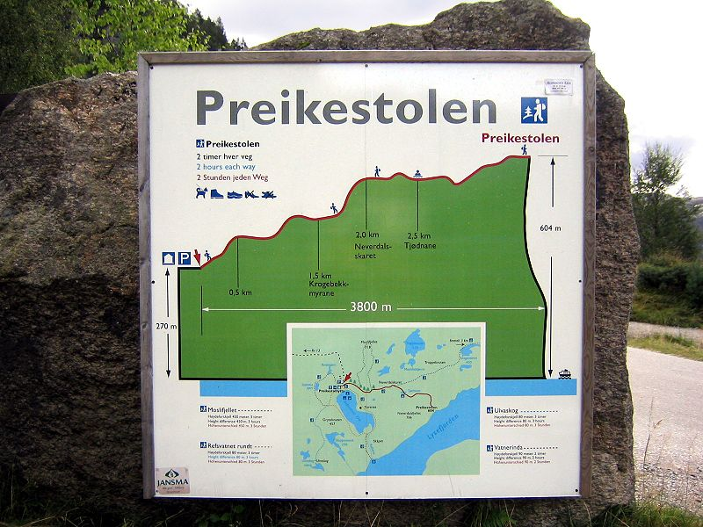
The map that shows the route and the altitude of Preikestolen shown on the marker.

Slide 5
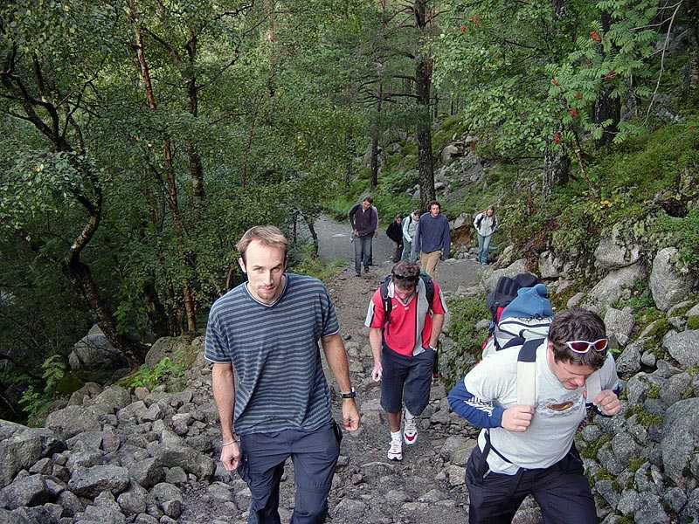
Beginning of the climb

Slide 6
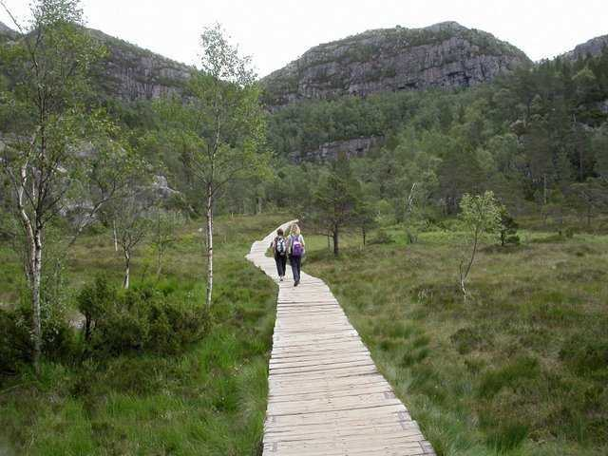
Wooden path to get over the sodden surface

Slide 7
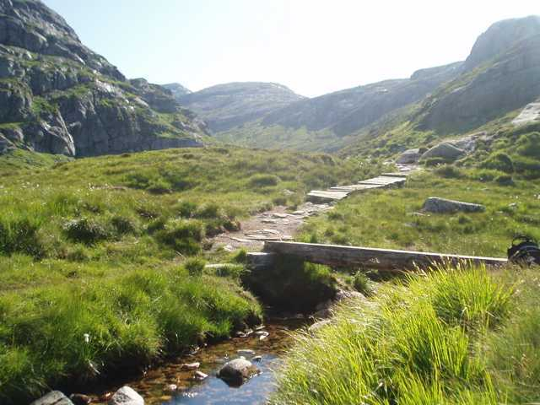
The trail goes on

Slide 8
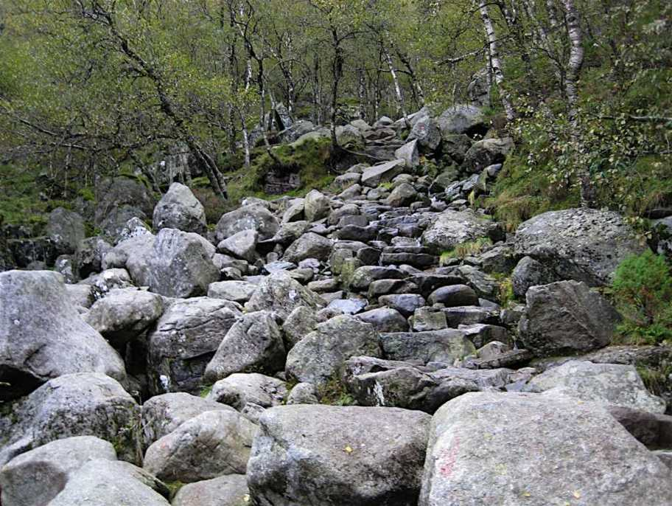
From here on the climb gets hard

Slide 9
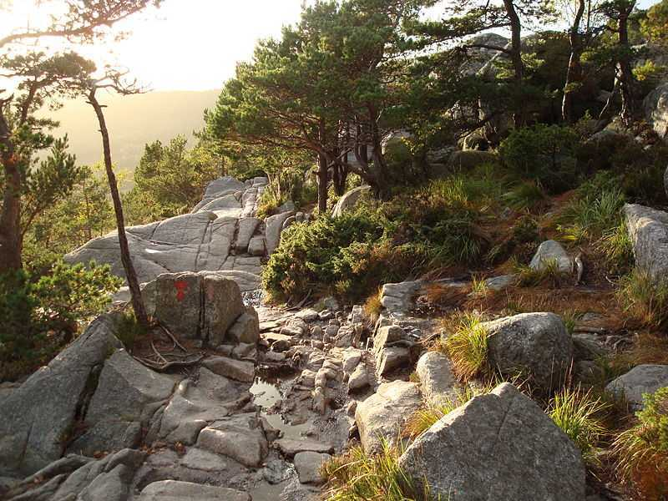
You have to climb up stretches full of rocks

Slide 10
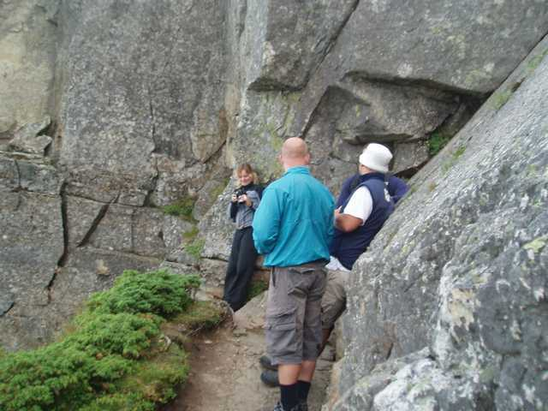
Here you stop to rest a little and take pix

Slide 11
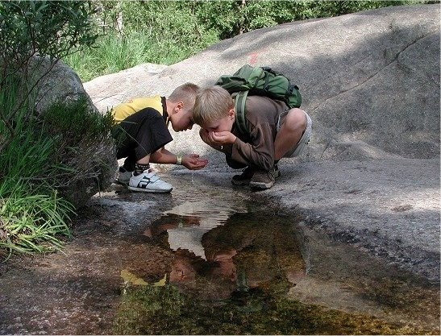
A little refreshment from the trickling stream

Slide 12
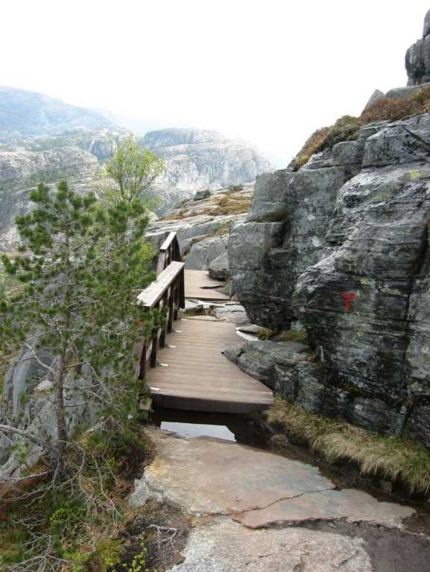
A little more dangerous going crossing a suspended bridge

Slide 13
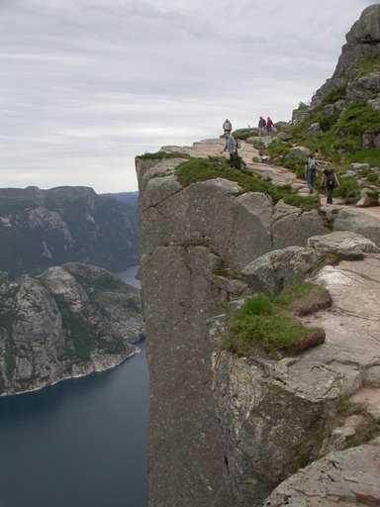
Almost there

Slide 14
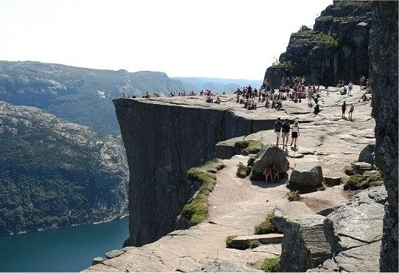
And here we are finally!

Slide 15
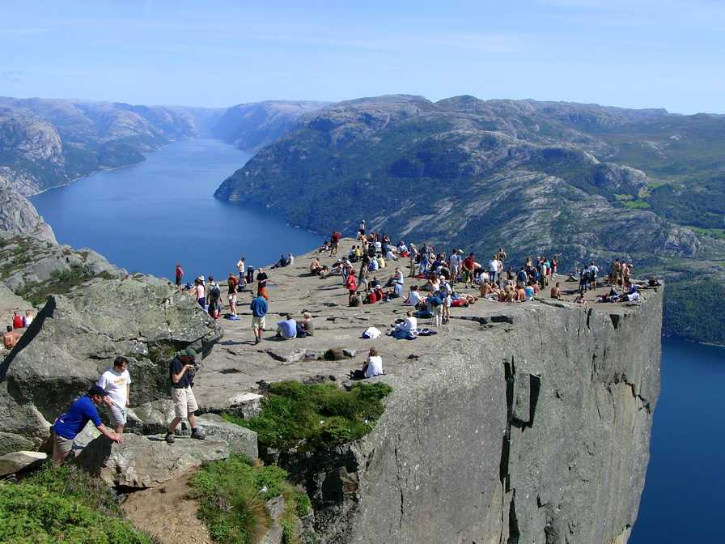
From here the pictures don't need any commentary. But if you suffer from vertigo' I would advise you not to look down!

Slide 16
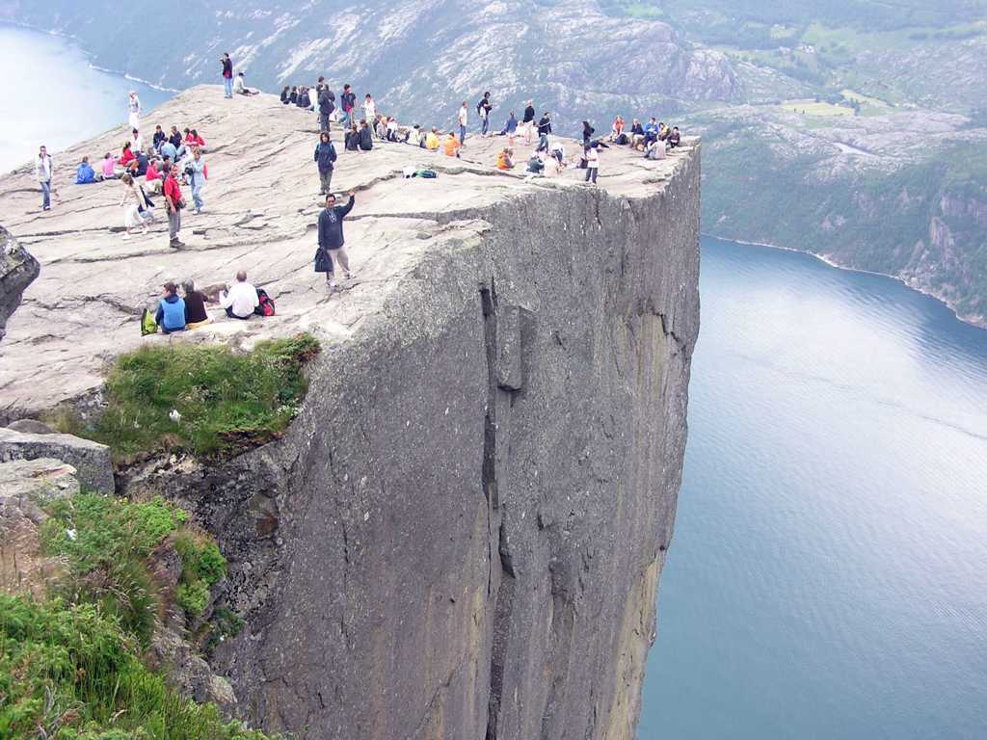

Slide 17
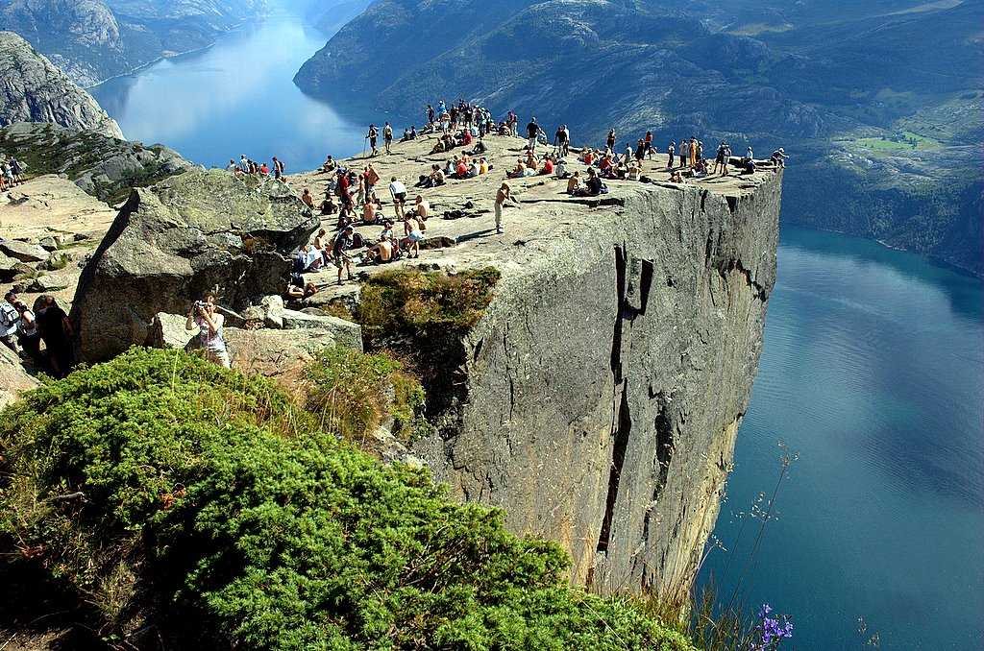

Slide 18
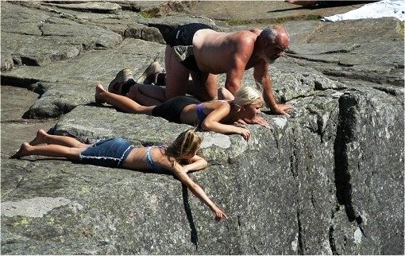
Grandpa not affected!

Slide 19
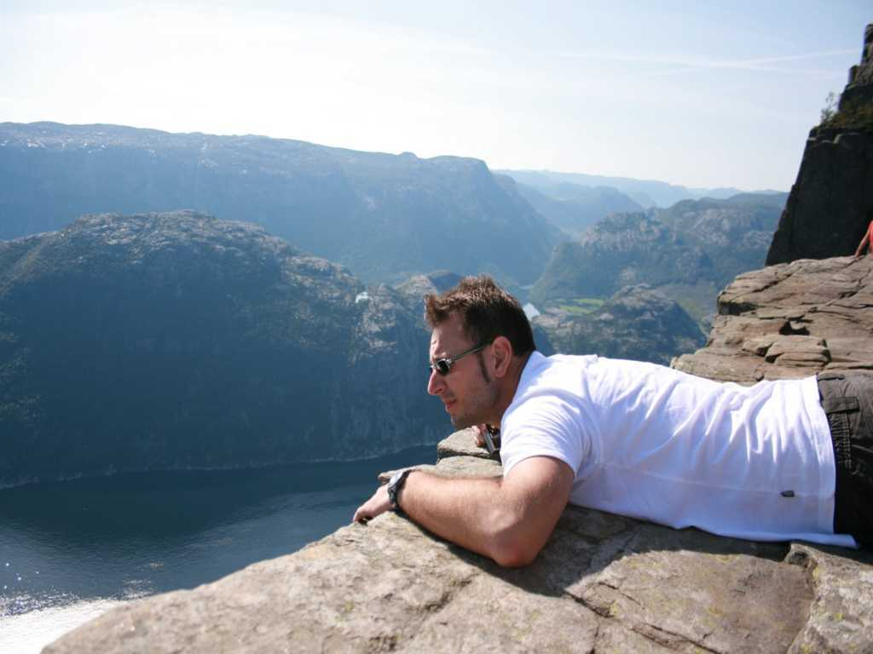

Slide 20
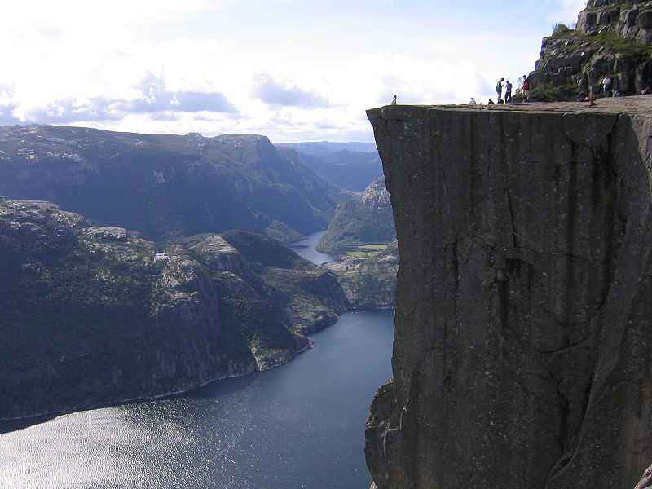

Slide 21
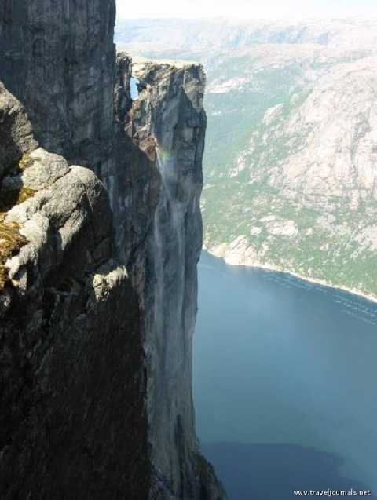
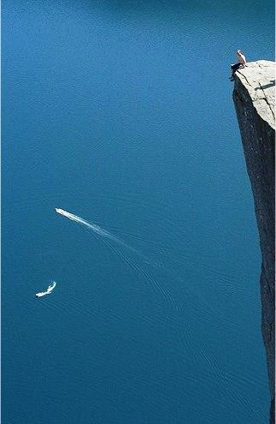

Slide 22
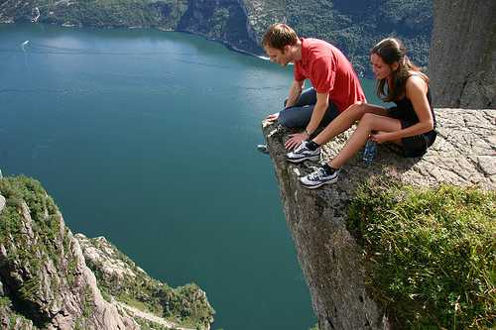

Slide 23
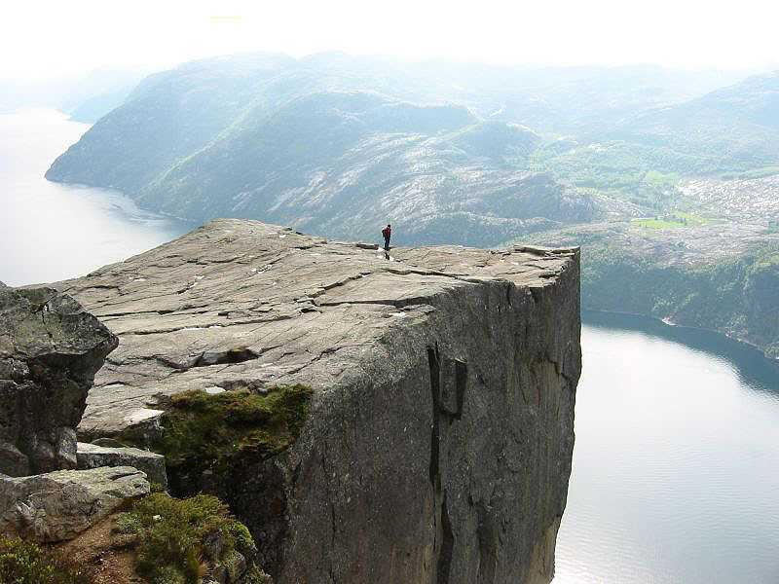

Slide 24
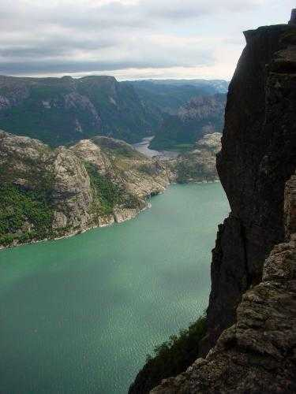
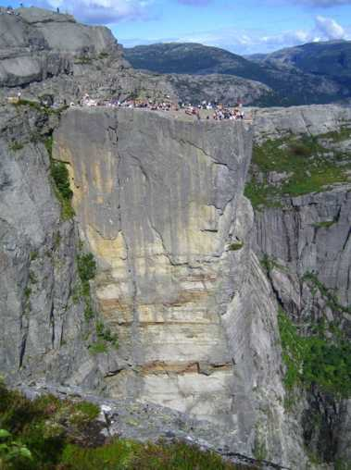

Slide 25
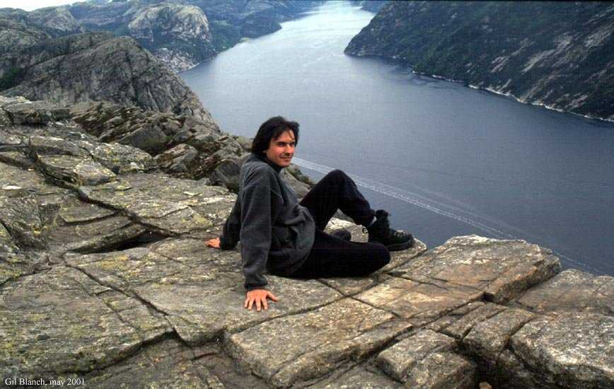

Slide 26
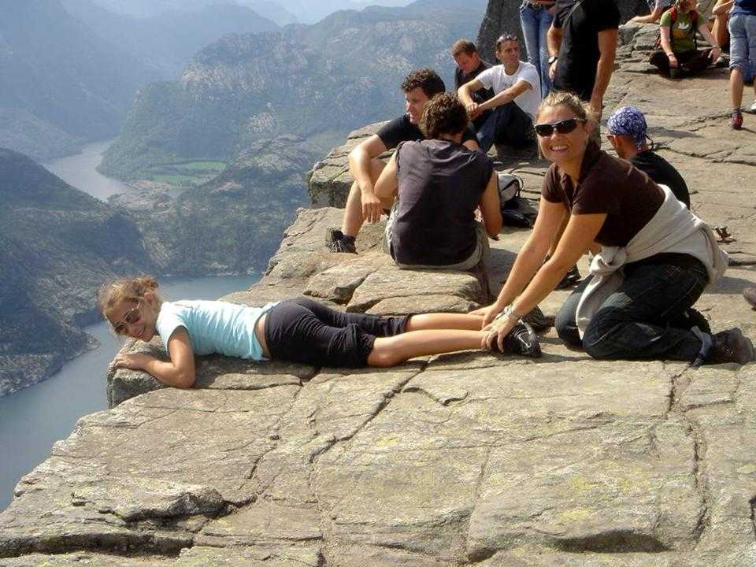

Slide 27
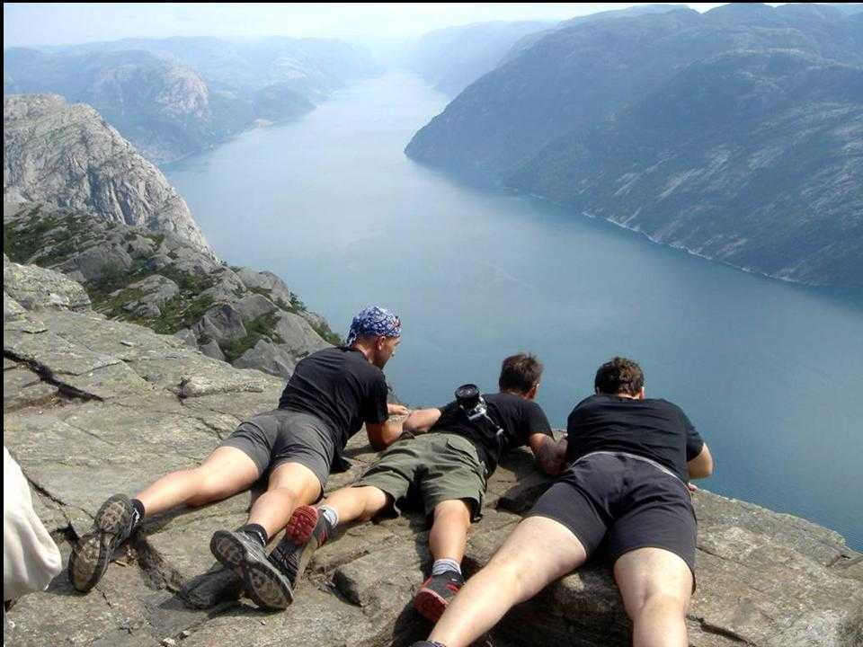

Slide 28
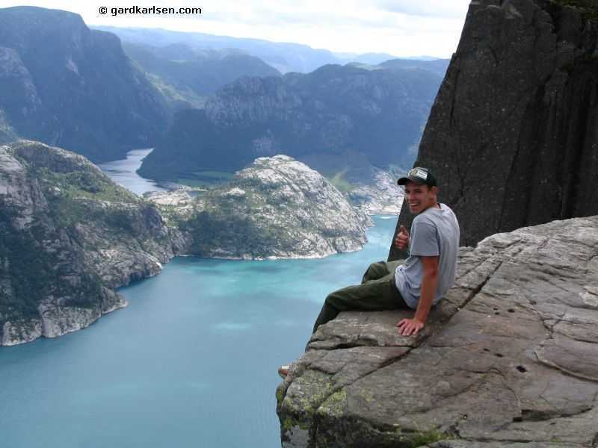

Slide 29
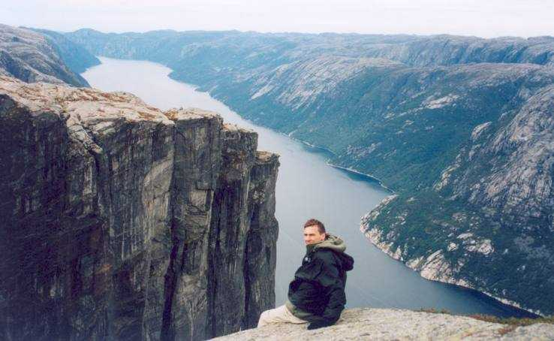

Slide 30
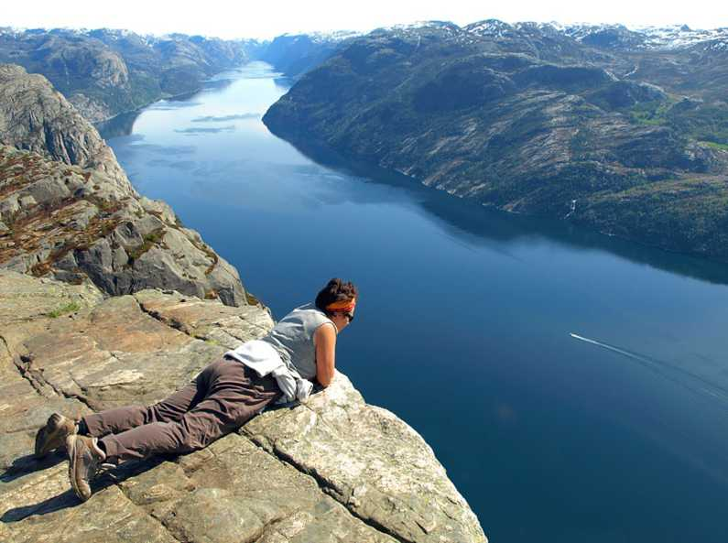

Slide 31
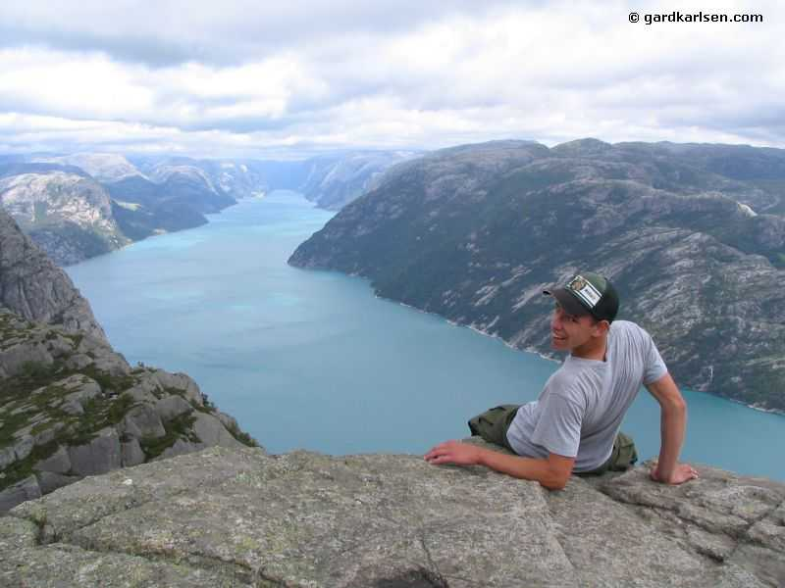

Slide 32
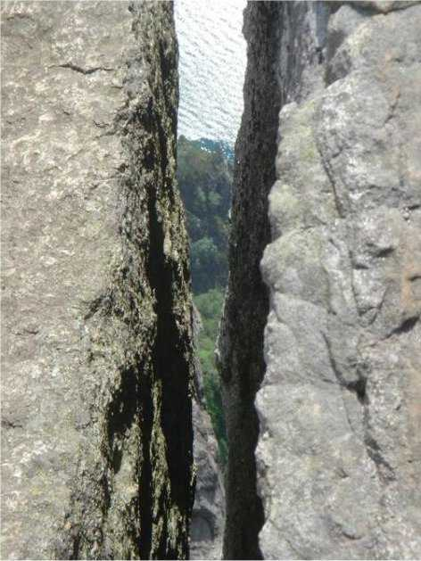
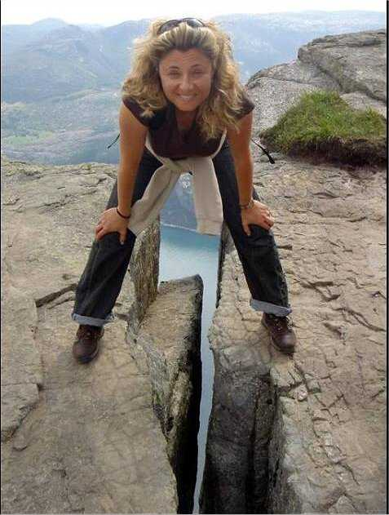
The big fissure that splits the rock down to the sea

Slide 33
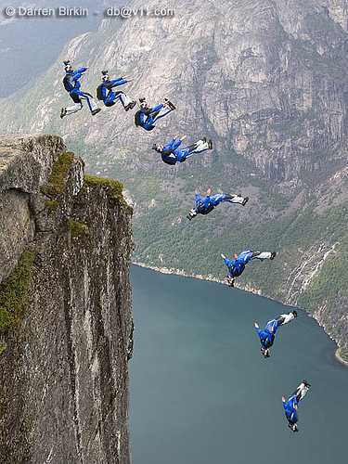

Slide 34
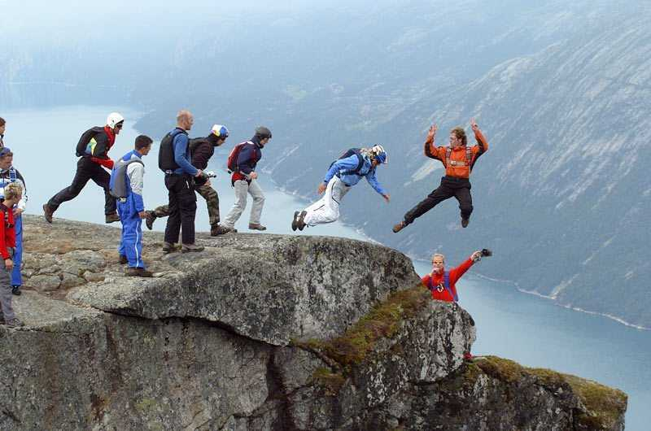

Slide 35
In the vicinity of Preikestolen there are so many beautiful places worth seeing but one stands out above all the others and it is
“THE MORTISED BOULDER”

Slide 36
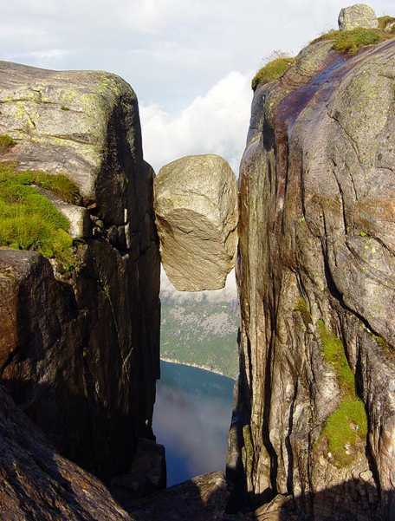
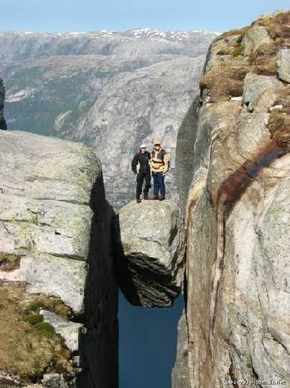

Slide 37
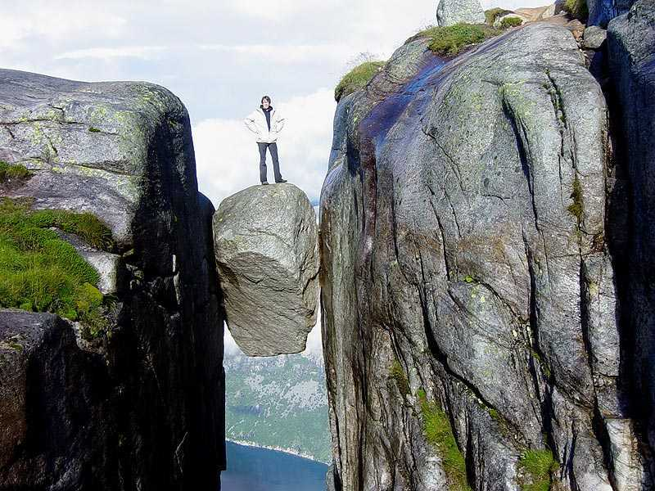

Slide 38
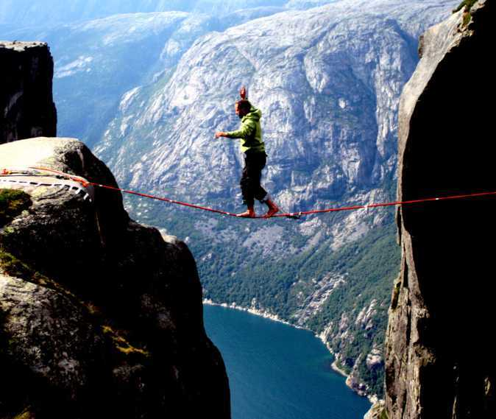

Slide 39
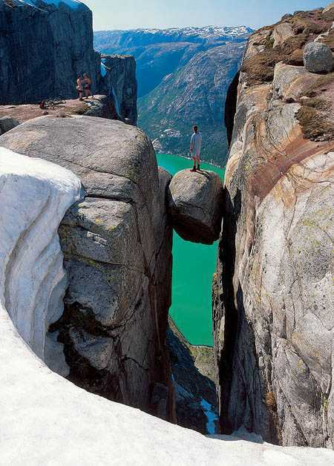

Slide 40
The End

